Slide 1
TEXTUAL ETL – OPENING
UP NEW WORLDS OF OPPORTUNITY

Slide 2
.Doc
Email
Program
.Txt
The informal systems of the corporation:
The formal systems of a corporation:
- unstructured data
- structured systems
- structured data
- .doc files
- .txt files
- .xls files
email
transcripted telephone
- corporate transactions
- corporate reports
- corporate databases
-customer files
- audit reports

Slide 3

.Doc
Program
Email
.Txt
There is a gulf between the two worlds:
- technology
- business practice
- organizational
- historical

Slide 4
.Doc
textual
ETL
Program
Email
.Txt
by moving textual data to the structured environment, you can
take advantage of the infrastructure for analysis that has already
been built –
- DB2
- Business Objects
- Cognos
- Hyperion
- Sand
- Crystal Reports, etc

Slide 5



.Doc
textual
ETL
Program
Email
.Txt
It seems I always have to
keep buying things. Then
I have to train people to
use them. When does it end?
I can save a lot by
reusing my existing
infrastructure
another good reason for textual ETL

Slide 6

.Doc
Email
.Txt
please do not confuse textual ETL
with search. Search technology assumes that
text is correct as written. Integration assumes
that text must be integrated before it can be
used for analysis
search
data mining
.Doc
textual
ETL
Program
Email
integration
.Txt
analytical processing

Slide 7

enterprise
content
management
unstructured
Documentum
Filenet
Stellent
others
enterprise
content
management
textual
ETL
unstructured
DB2
Oracle
Teradata
Sand
NT SQL Server
textual ETL is a necessary complement to ECM
if you want to make the data inside ECM usable

Slide 8

some of the kinds of documents that must be accounted for -
simple
unstructured
large documents with lots of text
- books, reports, patents,
contracts
semi
structured
smaller documents
resumes, recipe books,
tables, inspection reports
comments
raw notes
foreign
languages
email –
blather, volumes of documents,
little business content
location, time of day, time of year,
personal status, physical description,
etc.
text –
a complex
universe
implied
context
informal
conversation
slang, incomplete sentences
interruptions, unusual terms

Slide 9
.Doc
textual
ETL
Program
Email
.Txt
integration
perhaps the most important aspect of the preparation
for textual analytics is that of the need to address
terminology
cardiologist
they are all talking about the same thing,
but they are speaking different languages
orthopedics
nurse
general
practitioner

Slide 10
.Doc
textual
ETL
Program
Email
.Txt
integration
“…he drove his Porsche and…”
“… the Ford dealership…”
“…ran by the Volkswagen…”
“…the manager of the Honda plant…”
“…he drove his Porsche/car and…”
“… the Ford/car dealership…”
“…ran by the Volkswagen/car…”
“…the manager of the Honda/car plant…”
when it comes time to do analysis, accessing words by categories
is as important as accessing words by their actual value.

Slide 11
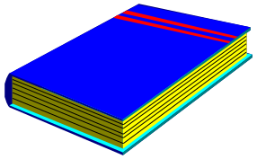

semi structured data
.Doc
textual
ETL
Program
Email
.Txt
integration
gumbo
okra
roue
salt
shrimp giblets
celery
……………..
jambalaya
shrimp
salt
sausage
onion
redfish
…………….
recipe book
Aha!
???

Slide 12
.Doc
textual
ETL
Program
Email
.Txt
integration
unstructured ETL –
- stop word processing
- stemming
- alternate spelling
- synonym concatenation
- homograph resolution
- spell checking
- words and phrases

Slide 13
.Doc
textual
ETL
Program
Email
.Txt
integration
semi structured ETL –
- mapping the internal structure of text by textual ETL
- variable pattern recognition
- variable symbol recognition
- multiple types of indexes
- utilities
- raw data hidden character display
- multiple path processing
- final index trimming

Slide 14







.Doc
textual
ETL
Program
Email
.Txt
integration
what happens when you just send raw text
over to the structured environment?

Slide 15
.Doc
textual
ETL
Program
Email
.Txt
integration
structured data integrated
into a data warehouse –
- SAP
- DB2/UDB
- NT SQL Server
- Oracle
- Teradata
and you can use standard
analytical tools –
- Business Objects
- Cognos
- MicroStrategy
- Crystal Reports
- SAS
- and many more
electronic text
- .pdf
- .doc
- .txt
- .xls
- .ppt
- comments fields
- Hadoop
- and many more

Slide 16
taxonomies
prebuilt
in multiple languages
.Doc
textual
ETL
Program
Email
.Txt
the integration of taxonomies into the
data warehouse environment is an
important component of integration

Slide 17
.Doc
textual
ETL
Program
Email
.Txt
integration
so who are some of the people using textual integration?
organizations that are concerned with safety –
- airlines, chemical manufacturers, oil and gas distributors, etc.
and what are they looking at?
- accident reports, inspection reports, repair reports, warranty data, etc.

Slide 18
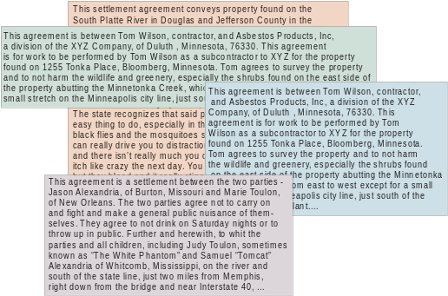
.Doc
textual
ETL
Program
Email
.Txt
integration
an important application is in terms of contracts.
what happens when a corporation has thousands of contracts?
handling a few contracts is one thing;
handling thousands of contracts is
something else

Slide 19
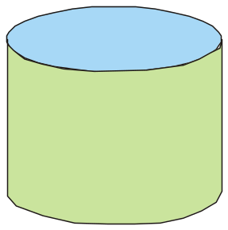

.Doc
textual
ETL
Program
Email
.Txt
integration
unstructured data
structured data
DW 2.0
there are important business decisions that can be made
once the textual data is integrated into the structured,
data warehouse environment

Slide 20
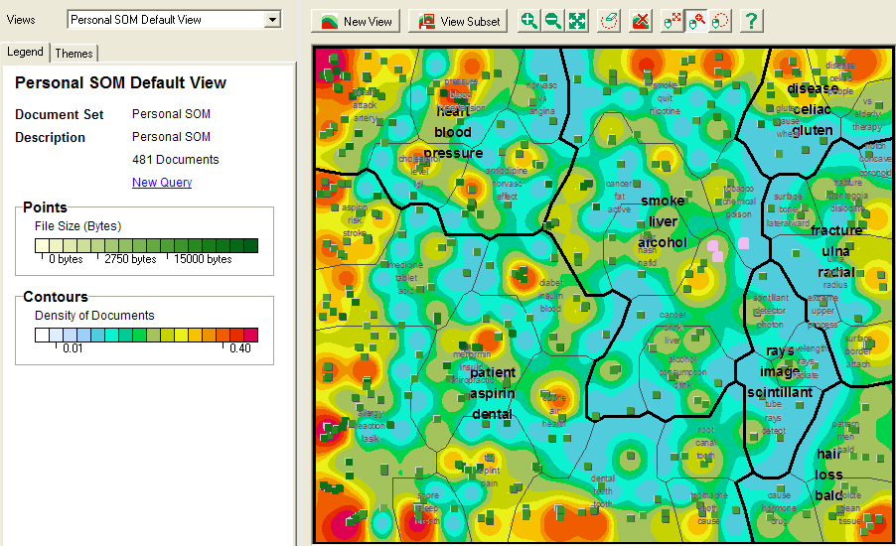
once the data has been collected and integrated into a data warehouse,
visualization is a possibility

Slide 21
.Doc
textual
ETL
Email
Program
.Txt
queries
visualization
two kinds of questions are answered -
visualization –
how can I discover what I need to know about?
unstructured data base –
once I know what is of interest, how can I investigate in great depth
the things that are of interest

